Slide 1
Traffic Safety
Resource Prosecutors
COURTNEY POPP
MOSES GARCIA
WASHINGTON STATE PATROL

Slide 2
Washington State Patrol
Washington Traffic Safety Commission
National Highway Traffic Safety Administration

Slide 3
Traffic
Safety
Resource
Prosecutors
State resource on DUI and traffic related prosecutions.
Liaison between prosecutors, law enforcement and traffic safety professionals.
Consultant on impaired driving crimes
Notes:
Actually a TSRP, is the State’s expert on DUI and traffic related prosecutions. A TSRP acts as a liaison between prosecutors, law enforcement and allied professionals. Not only works on the State and local level, but I serve as a national representative.
TSRPs are dedicated to eliminating their jobs by reducing alcohol related fatalities on America’s highways through improved enforcement and prosecution of impaired driving and other traffic laws. The TSRP contributes to better enforcement and prosecution through education, publications, technical assistance, interagency cooperation, general liaison in the traffic safety community and through development of their own expertise in the law, technologies and best practices in traffic safety.
Currently, 41 states (42 including the Northern Mariana Island) represented.

Slide 4




TSRP Partnerships
Work closely with State & National Organizations:

Slide 5
What is a TSRP?
Instructor for statewide education and training on impaired driving issues.
  Prosecutors
  Law Enforcement
  Judicial
  Community Groups
Represent prosecutors, law enforcement and traffic safety professionals on a state and national level.
  Legislation
  National conferences
  WIDAC
Resource for prosecutors on impaired driving legal issues.

Slide 6

Supporting Organizations
Washington Traffic Safety Commission
National Highway Transportation Safety
Administration (NHTSA)
Notes:
. . . And . . .

Slide 7
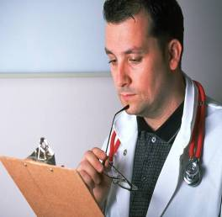
NHTSA’s Impaired Driving Strategies
High visibility enforcement.
Prosecutors & DUI Courts.
Screening & Brief Intervention.
Notes:
Finally, the need for alcohol treatment has been recognized by NHTSA. They are encouraging medical professionals to become involved in screening for alcohol problems and intervening when such problems are uncovered.

Slide 8
Notes:
First, let’s look at what we know about this battle at the National level. As you can see from this 2004 Crime-Crash Clock, there is a problem. We are losing way too many of our brothers, our sisters, our parents, our friends and our children on the Nation’s roads. Due to the nature and complexity of DUI cases, I spend most of my time focusing on this crime.

Slide 9
What is Our Goal?
Zero Deaths and Zero Disabling Injuries by 2030

Slide 10

Strategy For Teamwork
Prosecutors
Law Enforcement
Crime Lab
Victims
No single individual, agency or advocacy group can succeed with such a massive undertaking on their own.

Slide 11
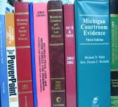
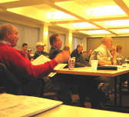
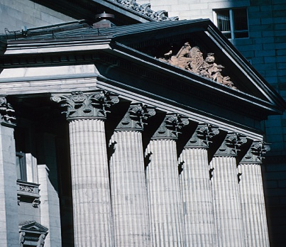


Objectives
Resource
Training
Communication
Liaison
Notes:
Each TSRP has four main objectives.

Slide 12
Training Objective
Provide training and assistance to prosecutors, law enforcement, and judges.
  Practical DUI: Nuts & Bolts
  Prosecuting the Drugged Driver
  Protecting Lives, Saving Futures
  Toxicology Training for Prosecutors
  Cops in Court
  Case Law Updates

Slide 13
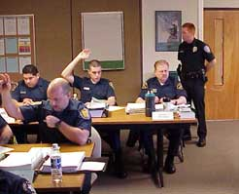
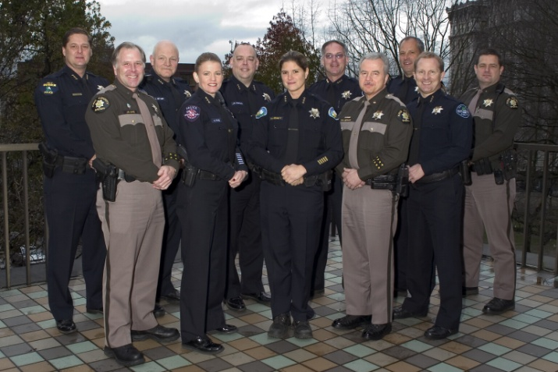
Training Objective
Training Opportunities for Law Enforcement:
  DUI Law for Basic Academy
  Legal Updates
  DRE School
  DUI refresher training

Slide 14
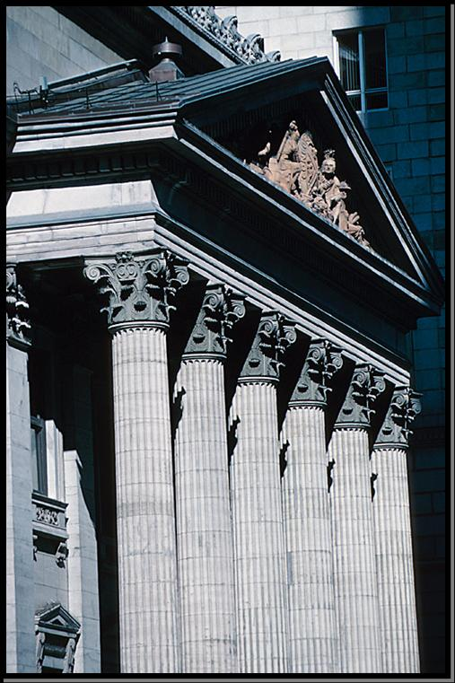
Resource Objective
Serve as a Resource:
  Brief Banks
  Expert Witness Banks
  Specific Case Analysis
  Court Watch
  Jury Instructions
  Predicate Questions
  Individual Technical Assistance

Slide 15
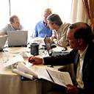
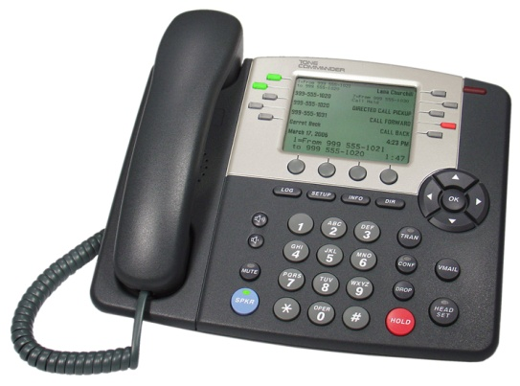
Communication & Liaison Objective
Between, Among and For:
  Prosecutors
  Law Enforcement
  Toxicologists
  Victim Advocates
  Traffic Safety Commission
  Legislators
  Advisory Committees/ Commissions
Notes:
Q for Prosecutors, “What recent issues have you faced in your office.”
After response, then ask, “Who here has also faced the same or similar issue.”
My role is to be the dispatcher in one location who takes the issue and provides the answer. Be connected to each office, therefore knowing where to find the answer.
From the first few weeks on the job, I gained a greater understanding of how many players and the vast resources there truly are when it comes to traffic safety violations. I have met with toxicologists, DRE instructors, DUI Task Forces, STEP, ALS Administrative Hearing Officers, Alcohol & Beverage Control, EUDL, RADAR, MADD, SADD, TVADC, RAC, Drug Court coordinators, Drug Czar, judges, prosecutors, probation officers, Traffic Reconstruction Investigators, Alcohol Evaluators, Expert Witnesses, Engineers, and the list just keeps getting larger as I settle in to this position.

Slide 16

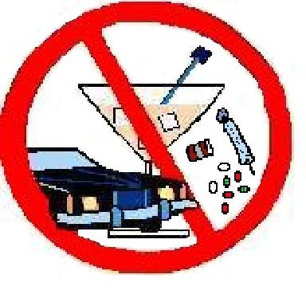
Networking
NHTSA-NAPC Fellow
National Traffic Law Center
Traffic Safety
Resource Prosecutors
Notes:
Networking. TSRPs have connected across the country – defense experts are crossing borders. Issues start in Maine and go to California. We have a network to communicate and keep in touch in order to be proactive, not reactive.
A key component to that network is NTLC.
The American Prosecutors Research Institute's National Traffic Law Center (NTLC) is a resource designed to benefit prosecutors and our traffic safety partners. The mission of the NTLC is to improve the quality of justice in traffic safety adjudications by increasing the awareness of highway safety issues through the compilation, creation and dissemination of legal and technical information and by providing training and reference services.

Slide 17
What You Can Do To Help
  Education on why traffic safety matters.
  Asking prosecutors to attend your traffic safety events.
  Patrol Ride-a-longs and Courtroom Ride-a-longs.
  Invite them to conduct trainings for your department. (teacher often becomes the student)

Slide 18

Benefits of a Team Approach
More thorough investigations
More arrests
Law enforcement weighs in on plea agreements
Prosecutors involve LE and victims in plea agreements
Increase in convictions
Special consideration given to cases filed by proactive LE
Sustained high visibility law enforcement, coupled with swift and certain punishment.

Slide 19
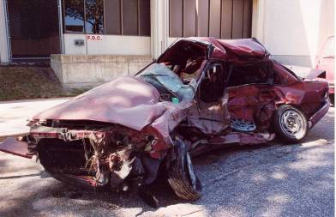
How Else Can the TSRP Help You?
The only limitation is our imagination:
  In-Service Training
  Public Meetings
  Academies
  Briefs/Suppression Motions
  Multi-Agency Meetings
  Community Outreach

Slide 20

What the TSRP Needs From You!
Active Participation
Interesting/Unusual Case Scenarios and Issues
Transcripts
Feedback on How to Better Assist You!

Slide 21
Contact Information
Courtney Popp
Traffic Safety Resource Prosecutor
Washington State Patrol
811 E Roanoke Ave
Seattle, WA 98102
(206) 720-3018 office
(206) 720-3023 fax
Courtney.popp@wsp.wa.gov
Moses Garcia
Traffic Safety Resource Prosecutor
Washington State Patrol
811 E Roanoke Ave
Seattle, WA 98102
(206) 720-3018 office
(206) 720-3023 fax
Moses.garcia@wsp.wa.gov

